Slide 1



Page
01
Team SAVS
EMI
WALLET
EVERY TRANSACTION MATTERS!
REVA HACK 2022</>
48 Hours Hybrid International Hackathon
11th Nov - 13 th Nov
Venue: REVA University, Bengaluru

Slide 2

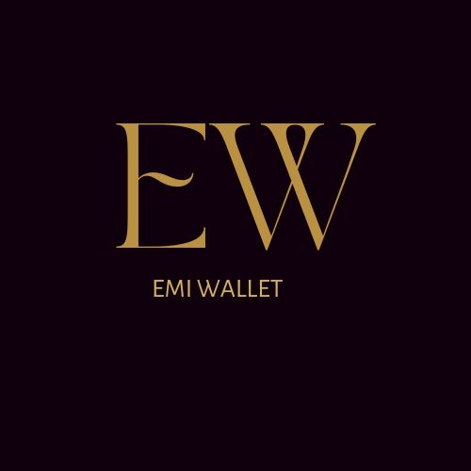

PROBLEM STATEMENT
Page
02
REVA HACK 2022 </>
Money management system and lack of people who are investing there money to grow
Lot of opportunity to make money
Only 7% of Indian investing in stocks. Why? Because Most of them are busy in paying there EMI bills.
71% of Indians are spending there salary to pay EMI bills.
Here in India ,people do have more than one source of income but they are not able to manage there money.
We have never thought that we can actually convert those other source of income to pay our big EMIs and we are always stick to pay via salary.
So, introducing to you EMI wallet, an application which will help you to pay your money on time without any penalty and grow your money if you invest it.
Small amount----→Big EMIs
Half salary
Gone for EMI

Slide 3
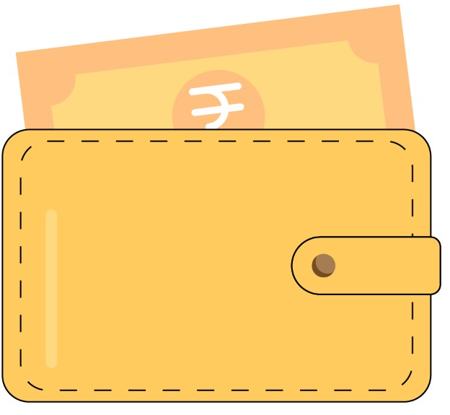
Page
03
INTRODUCTION
An app solely made for the users aiming to save up money for future investments. This app is based on the blockchain technology wherein only the necessary data and a certain amount of money is shared among the users.
Rather than spending the money on EMIs from salary or a single source of income, the money from other multiple sources are used up in paying the EMIs in the first few days of the month. The money from other sources of income are used to pay the EMIs as prioritized by the user.

Slide 4
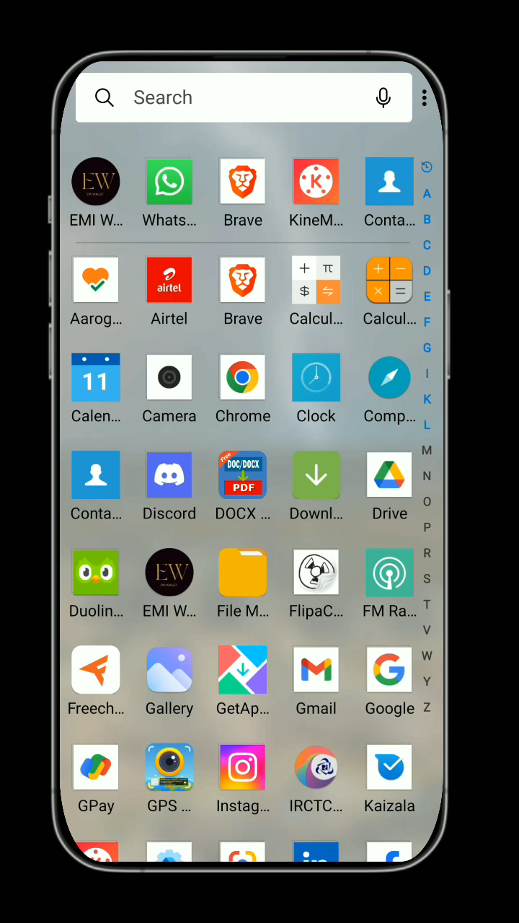
04
REVA HACK 2022 </>
Page
SOLUTION

Slide 5

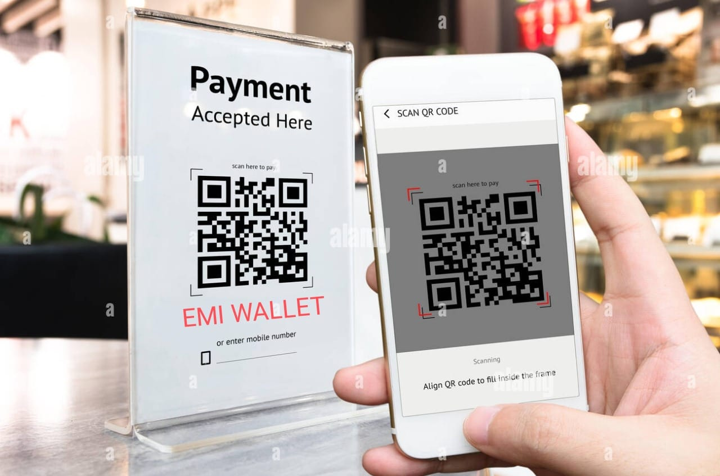
05
Page
REVA HACK 2022 </>
About Application
EMI Wallet is an Android application in which the user's large EMI can be paid in small portions.
If a person has to give some money to another person, then the first person will not ask him for that money in his bank account, he will tell him that you put that money in my EMI wallet. EMI Wallet will keep those money in small amounts and as soon as his first EMI amount is reached it will auto pay his first EMI.
Shopkeepers can also do this work. Those people will put the QR code of the EMI Wallet in front of their shop and if a customer pays them, then that money will go to the EMI Wallet and from there his EMI will start getting paid.

Slide 6
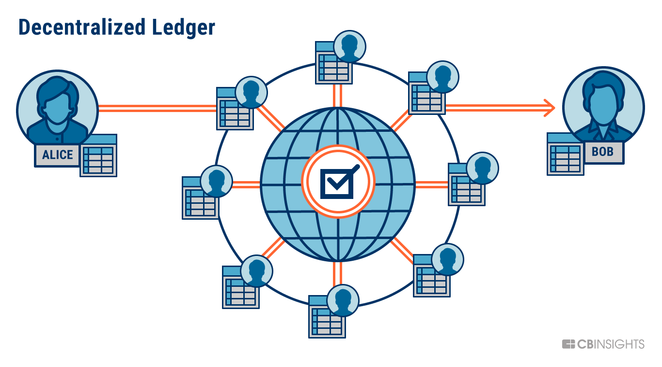
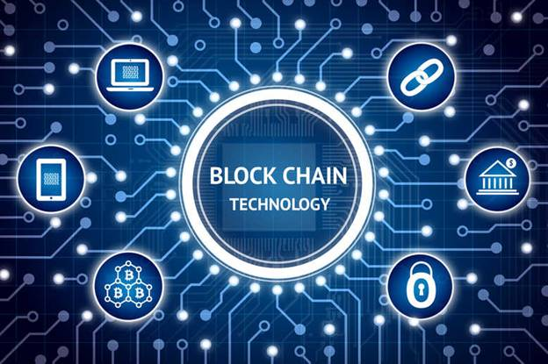
Fintech and blockchain
06
Page
REVA HACK 2022 </>
A blockchain is like a database; it's a way of storing records of value and transactions.
Blockchain is a distributed ledger management technology that can be used for transactions between two people or to track custody of couriers, Since transactions are recorded in almost real-time.
Blockchain is a platform that allows the recording of information in an extremely secure way, making it near-impossible to alter or break into the system. Blockchain has been described as a digital ledger of records called blocks, which are used to record transactions and track assets in a business network. It is known to democratise processes, ensuring security, transparency and efficiency, with one of the most attractive qualities of this technology being decentralised ownership.

Slide 7
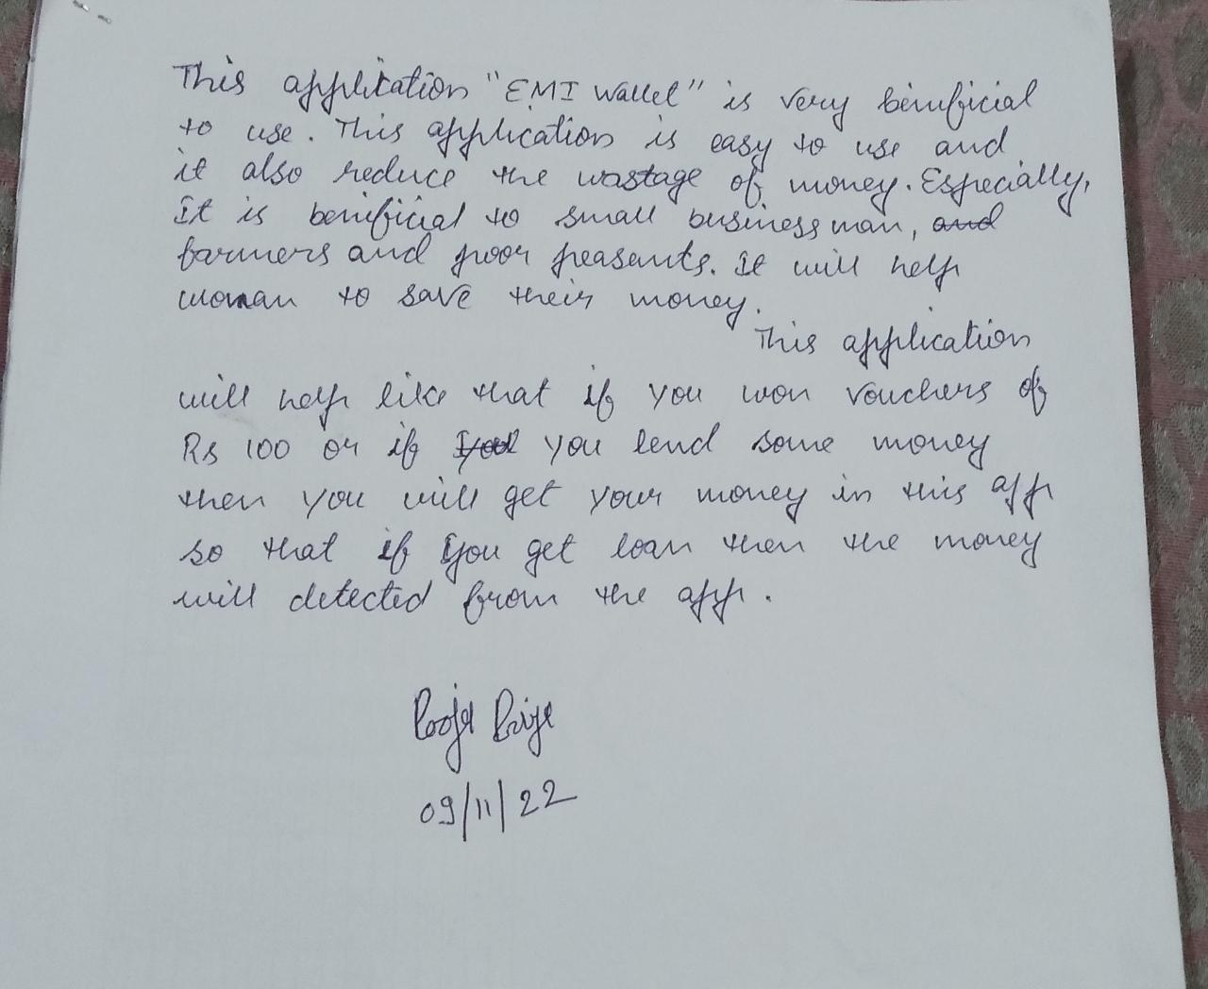
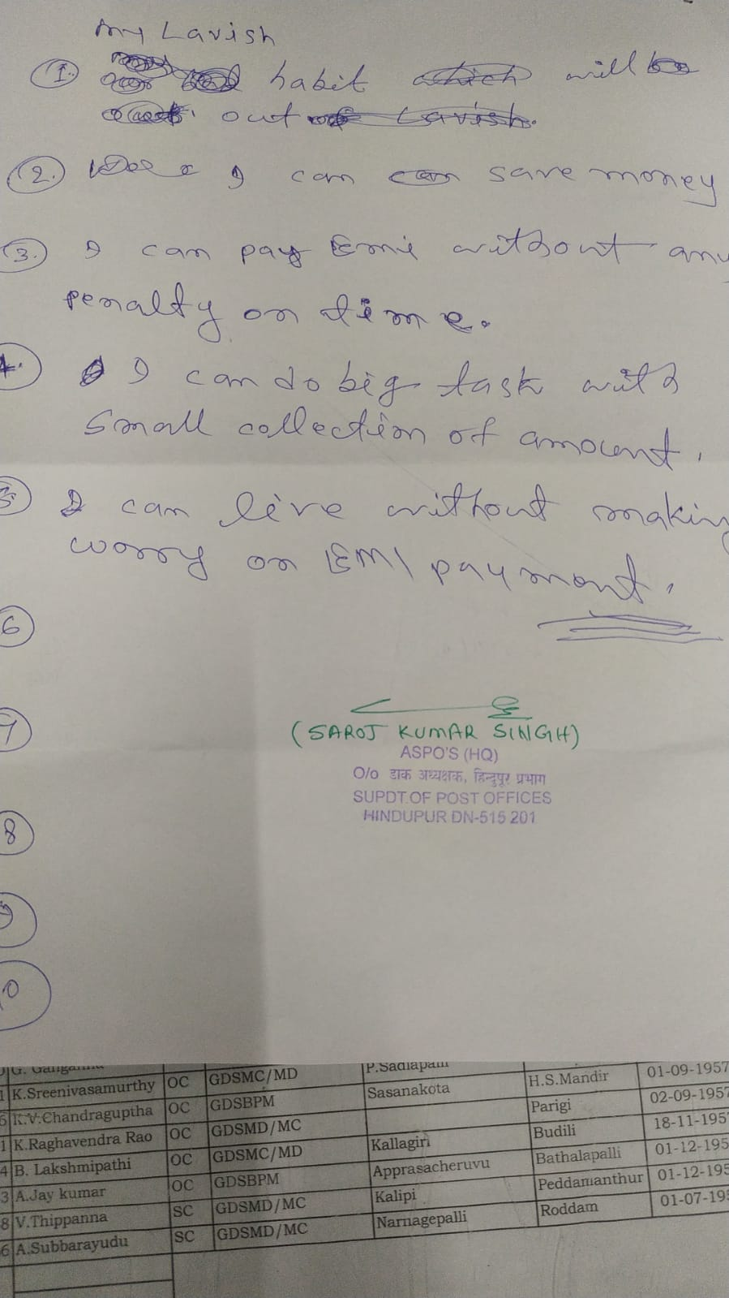
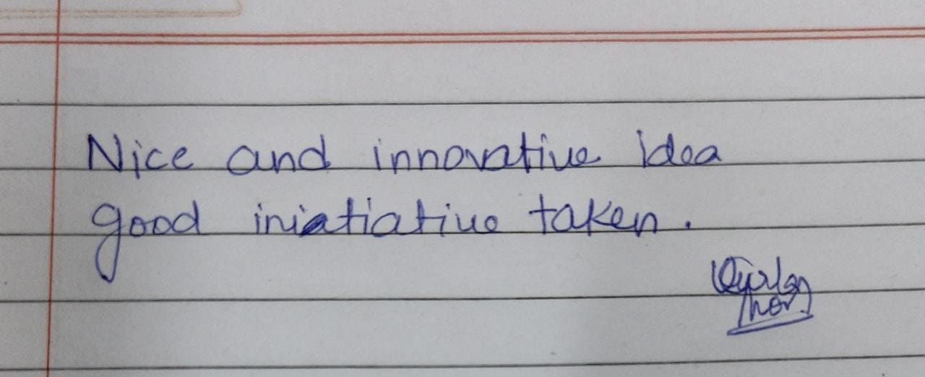
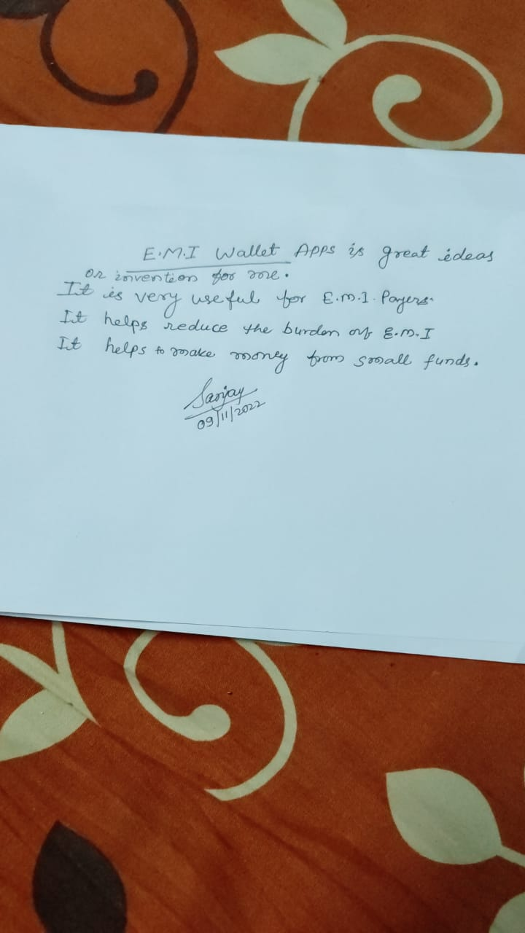
07
Page
LITERATURE SURVEY

Slide 8

08
REVA HACK 2022 </>
Page
Reason 1
Reason 3
Saving money from one's monthly salary can be used to invest in stocks, therefore enhancing one's finances.
EMI wallet can be effective at managing one’s financial matters.
CONCLUSION
Reason 2
Reason 4
When EMI is not paid, money is auto-paid from multiple sources, thereby preventing penalties.
The stress of having less money every month can avoided.

Slide 9



Page
09
THANK
YOU!
We will get back to you two weeks prior to the hackathon

